Slide 1
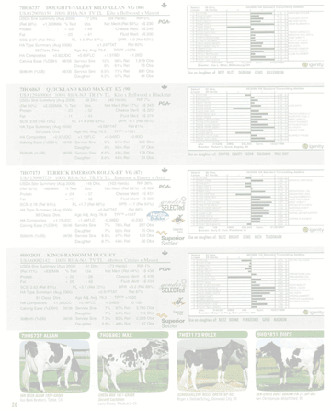
i
DHI-The is for
INFORMATION

Slide 2

Mission Statement
“To serve National DHIA members and the dairy industry
in advancing dairy information services.”
Vision Statement
National DHIA will lead the dairy information industry to create,
utilize and advance world class information resources
that are accurate, credible and uniform.
We will accomplish this by:
- Ensuring information accuracy
- Representing and supporting our members’ interests
- Being the direct voice for the dairy information industry
- Working with industry partners

Slide 3
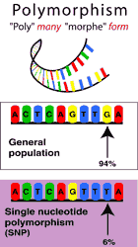
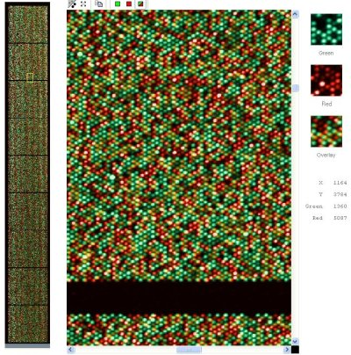
Genotype
Polymorphism
“poly” = many “morph” = form
General
population
94%
Single nucleotide
Polymorphism (SNP)
6%
GG
GT
TT

Slide 4
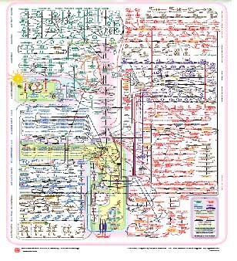
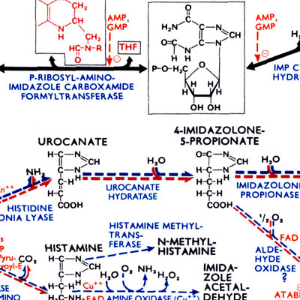
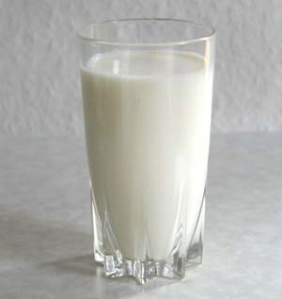
Phenotype

Slide 5
Match Made In Heaven

Slide 6
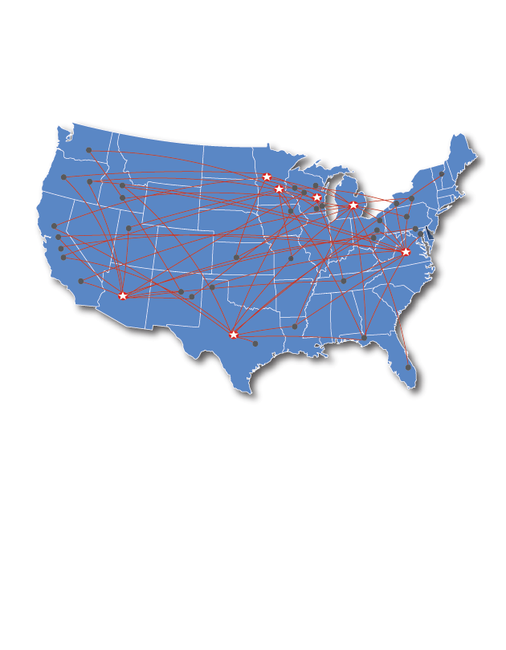

Consider the possibility…
to enhance:
to improve:
4.5 million cows
Network of laboratories
coast to coast
Canada to Mexico
Sustainability
Production efficiency
Product Quality
Surveillance
Animal Health
International Competitiveness
Genomics

Slide 7
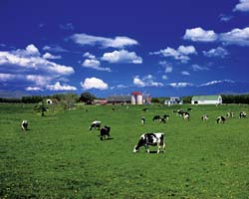
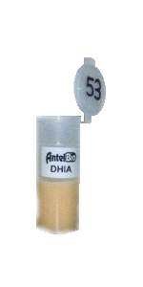
How Much Information is in Milk?
metabolites
antibodies
DNA
antigens
Everything
  Cow
  Environment
Notes:
Invention vs Discovery

Slide 8
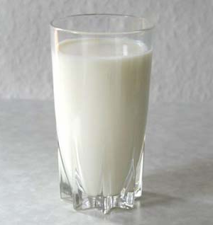
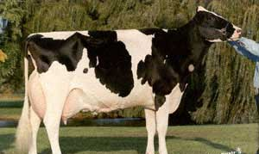
Altering the Nutritional
Value of Milk
Fatty Acids
(CLA)
Caseins
(A1/A2)
An optimal milk exists
  Phenotype/Genotype
?
=

Slide 9
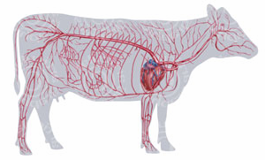
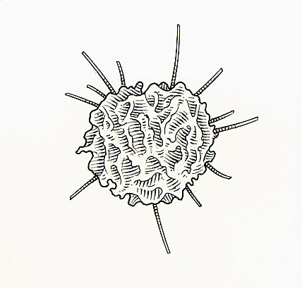

Mastitis-Udder Infection
In early stages of infection,
there’s communication going on
  Discover the language!

Slide 10

Johne’s Disease
Could milk work?

Slide 11

Johne’s
Mycobacterium avium subspecies paratuberculosis
(MAP)

Slide 12
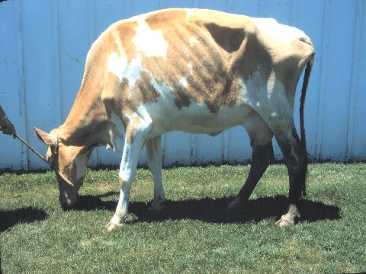
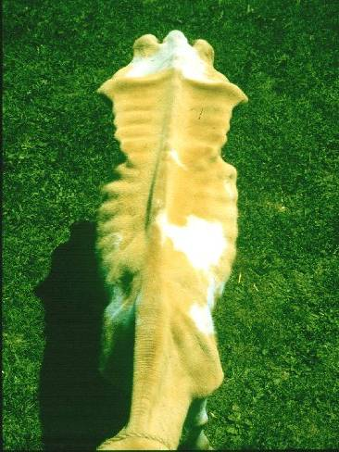
Johne’s
Won First Place in County Fair - Two Months Prior
Robert Whitlock, University of Pennsylvania

Slide 13
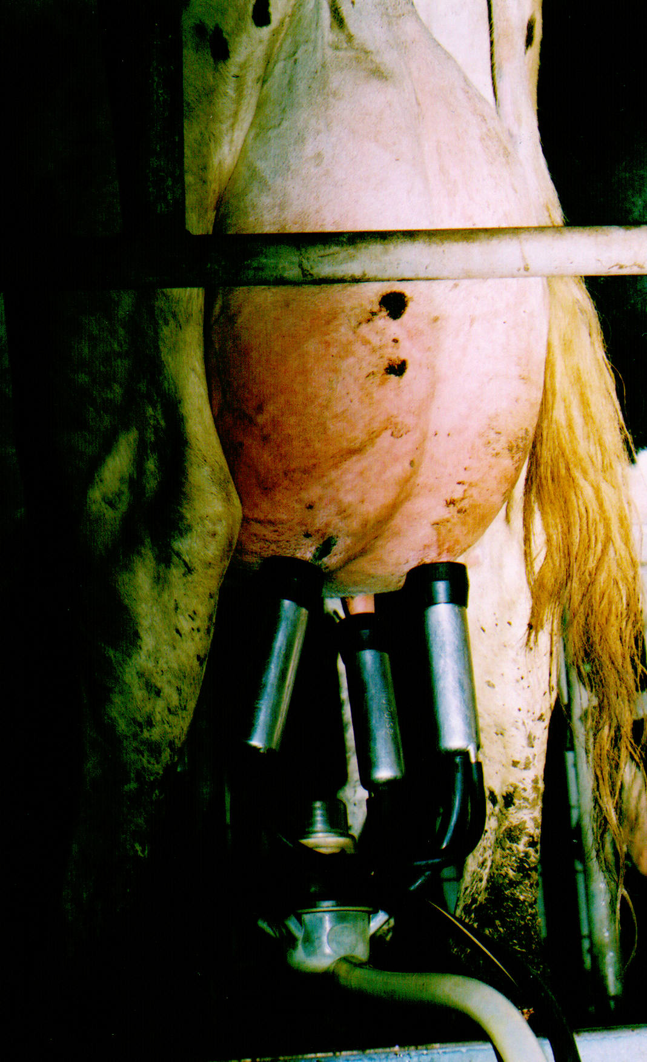
Johne’s

Slide 14
Milk Johne’s Testing
22% increase in total sample volume from 2006

Slide 15

Milk Johne’s Testing Program
National Voluntary Program
  Looking to DHI as industry leader
Very Important Development
  Links DHI to Animal Health Programs
  Showcases DHI Infrastructure
TB
Brucellosis
Salmonella
Notes:
On the cusp

Slide 16
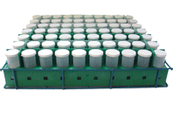
Milk Johne’s Testing Program
Advantages for Voluntary Program
  Sample’s already in labs
  Program built into dairy software
  Linked with performance data
$
Convenience!
Notes:
Picklists

Slide 17
Herd Management Report

Slide 18
Johne’s Disease
Could milk work?
✓
Leukosis

Slide 19
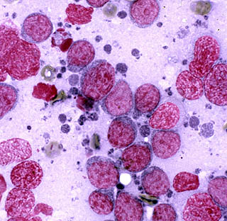
Leukosis
Leukosis
BLV – Bovine Leukosis Virus; Enzoonotic Bovine Leukosis

Slide 20
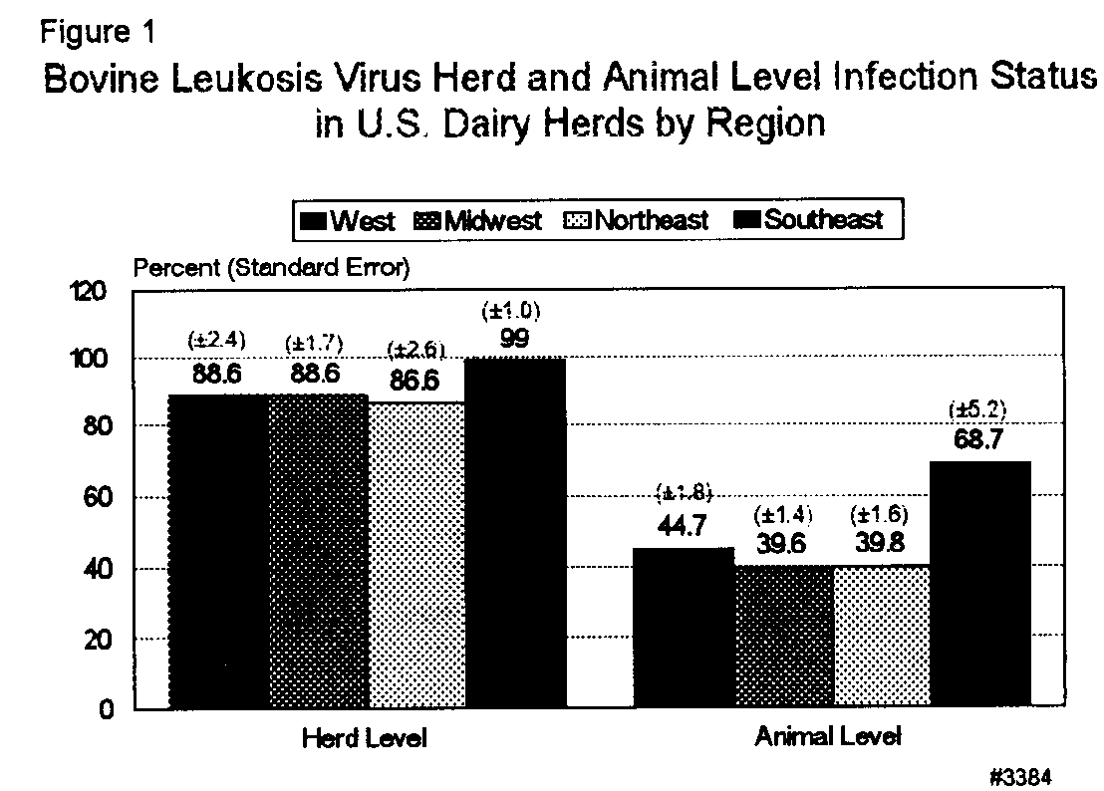
Leukosis
NAHMS ‘96

Slide 21
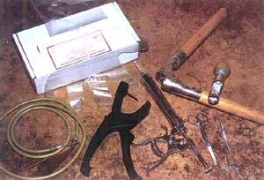
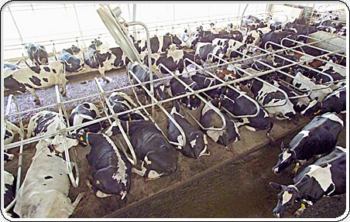
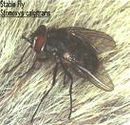
Leukosis

Slide 22
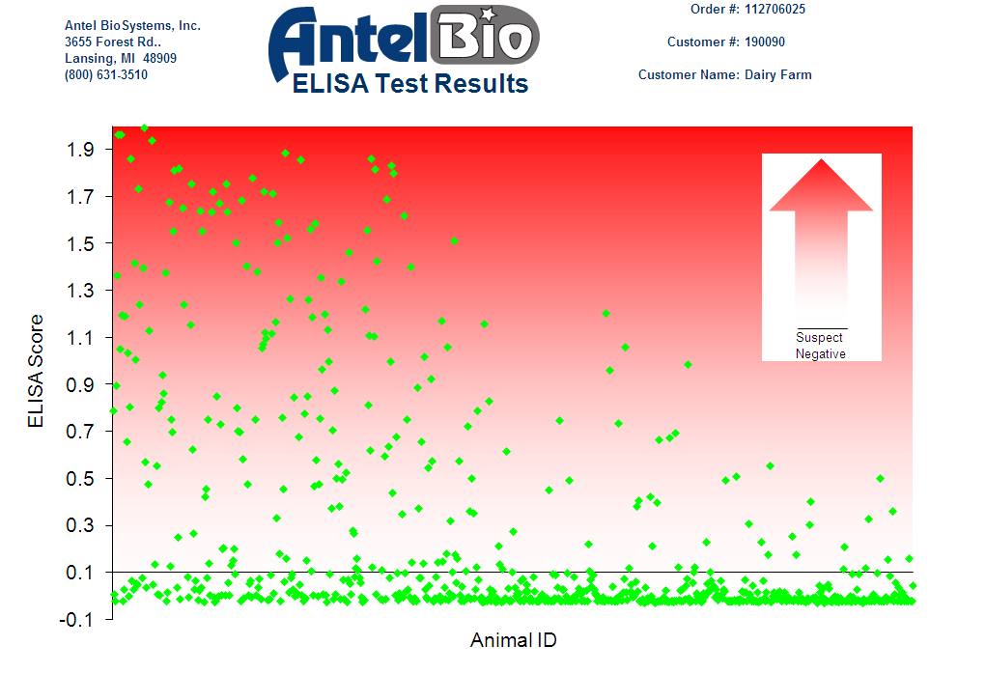
Leukosis Milk Testing Program
It’s the information!

Slide 23
Johne’s Disease
Could milk work?
✓
✓
Leukosis Disease
BVD

Slide 24
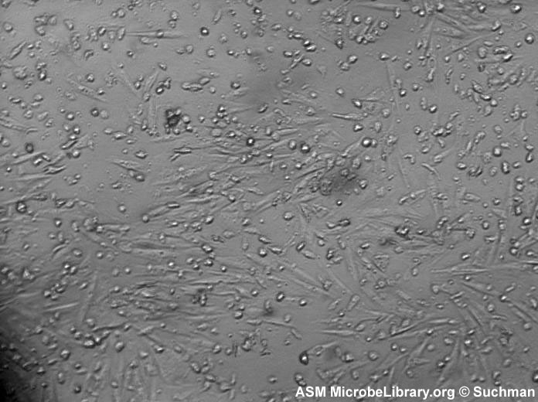
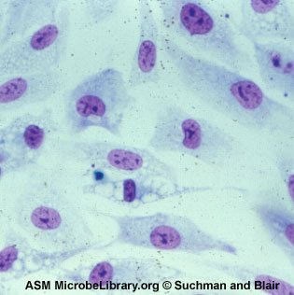
BVD
BVD
Bovine Viral Diarrhea

Slide 25
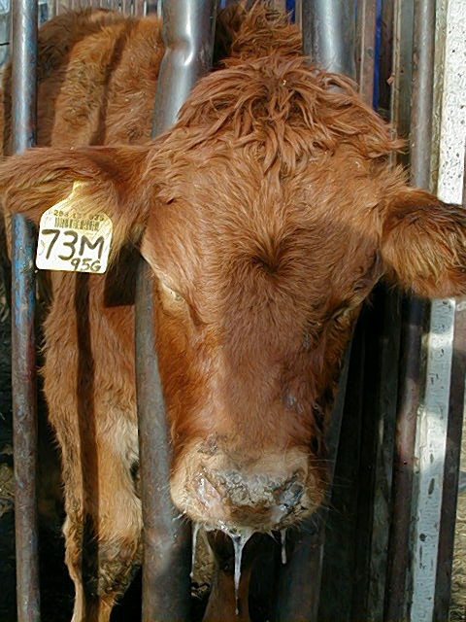
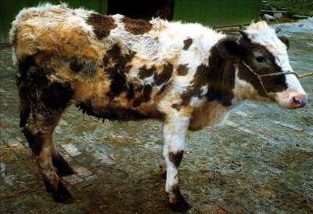
BVD
BVD

Slide 26
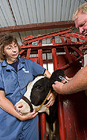
BVD Milk Testing Program
Traditional Program
  In line samples
  Ear notch

Slide 27
BVD Milk Testing Program
1000-Head Herd ($150 pooling fee)
  4 PCR X $40 = $160
  5 PCR X $40 = $200
  50 ELISA X $6 = $300
  Total $810/1000 = $0.81/Cow ($0.50-$2.50)
250 Samples
250 Samples
250 Samples
250 Samples
50 Samples
50 Samples
50 Samples
50 Samples
50 Samples
50 Samples
PI Cow

Slide 28
Johne’s Disease
Could milk work?
✓
✓
Leukosis Disease
✓
BVD
Progesterone

Slide 29
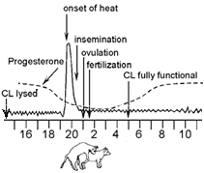
Progesterone Testing
Progesterone ELISA
  Individual animal test
  Quantitative ELISA
  High/low
Evaluation of Synchronization
  Progesterone from functional CL
  CL required to respond to synchronization
Figure 1. The estrus cycle near the time of ovulation.

Slide 30
Progesterone Testing

Slide 31
Progesterone Testing
Synchronization Program Evaluation
Figure 2. PreSynch + OvSynch
14 days
14 days
7 days
2 days
12 h
PGF_{2α}
PGF_{2α}
GnRH
PGF_{2α}
GnRH
AI
HIGH
HIGH
HIGH
HIGH
LOW
Desired Progesterone Levels

Slide 32
Progesterone ELISA
When Things Are Working

Slide 33
Progesterone ELISA
When Things Are Not Working

Slide 34
Proposed Progesterone Profiling
Identify and Test Critical Samples
Monitor % Non-compliance

Slide 35

Johne’s Disease
Could milk work?
✓
✓
Leukosis Disease
✓
BVD
4 for 4!
✓
Progesterone

Slide 36
Looking for Information?
It’s In Her Milk
Significant diagnostic opportunity
Immediate effects on management
Future effects on genetic selection
Enhance value of animal recording

Slide 37
